Slide 1
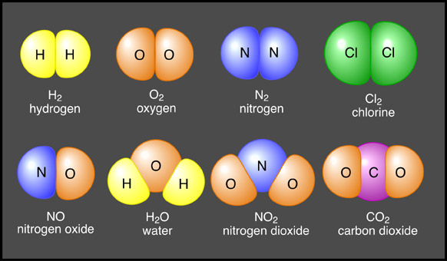
Atomic structure - Part 2
Element – Pure substance found on the earth, can be solid liquid or gas.
Represented by one or two letter symbols.
First letter is always a capitol letter second is always lower case.
Molecule – 2 or more atoms chemically bonded together.
Examples include O₂ , Cl₂, H_{2,} H₂O
Compound – 2 or more substances chemically bonded together
Contains more than one element
Represented by a formula
Examples include H₂O, NH₃, CO₂, CO

