Slide 1
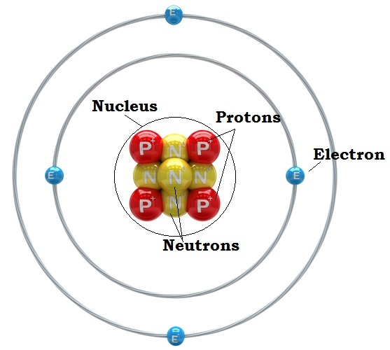
Atomic Structure
An atom is the smallest unit of matter
Proton: + charge in nucleus
Neutron: no charge in nucleus
Electron: - charge outside of nucleus
Each outer ring is an orbital or shell
1st shell holds a max of 2 e-
2nd shell holds a max of 8 e-
3rd shell holds a max of 18 e-
The Atomic # tells you how many protons there are.
In most cases it is also the number of electrons
The Atomic Mass is the average number of protons + the number of neutrons
Isotopes have a different # of Neutrons than protons

