Slide 1
Atoms and Periodic table Notes 7
Review
Remember: atomic number = protons = electrons.
The mass number is the mass (amu) of every proton plus every neutron. So…. Atomic mass – Protons (or atomic #) = neutrons.
Electrons should be placed on top, bottom and sides when drawing an atom
Protons are positively charged in the nucleus. Neutrons are neutral in the nucleus. Electrons are negative and outside the nucleus. They are attacted to the positive protons. Opposites attract.
New
Octet rule – for an element to be stable it wants its outer shell filled with 8 electrons.
This is why the noble gasses are stable. They have a full octet.
Elements will gain, loose or share electrons to get a full octet.
This process is called bonding. This is how molecules and compound are formed.

Slide 2
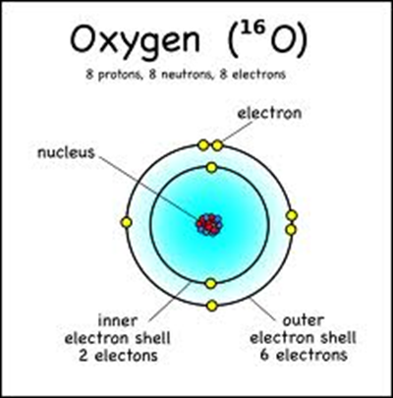
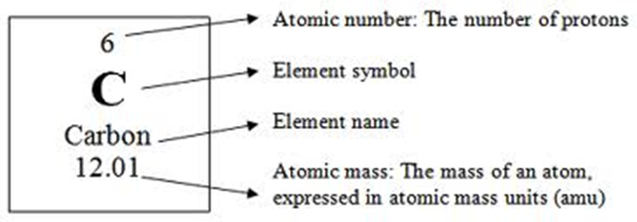
Ions - when an atom gains or looses an electron. So if the number of electrons is different than the number of protons, it is called an ion. Remember isotopes are different – they are when an element has a different number of neutrons.
Draw these picture and labels in your notes

