Slide 1
Bonding – Introduction May 12
Compound – 2 or more elements chemically bonded together
Formula – represents a compound
Subscript numbers represent the # of that element
For example: in 2H₂O – the 2 means there are 2 molecules of water and the ₂ means there are 2 Hydrogen atoms
chemical bond - atoms held together by attraction of atoms to each other through sharing, as well as exchanging, of electrons -or electrostatic forces.
Ionic bonding - When an atom (or group of atoms) gains or loses one or more electrons
Covalent bonding - the sharing of electrons between two atoms
Metallic bonding - between atoms of metallic elements, formed by the valence electrons moving freely (electrostatic forces)

Slide 2
Bonding - Introduction
Neutral atom – When there are the same amount of electrons as protons
Ions - when an atom gains or looses an electron (e⁻) and becomes positively or negatively charged
Remember isotopes are different – they are when an element has a different number of neutrons.
Octet rule – Atoms will gain or lose e⁻ to have a full valance shell of 8 electrons
Full shell = Stability
Elements that have > 4 valance e⁻ gain electrons (fill shell)
Elements that have < 4 valance e⁻ loose electrons (fall – to next full shell)
cation – when an element looses e⁻ and becomes a positively charged ion
Usually metals - represented by +1, +2, +3 or +4
anion - When an element gains e⁻ the atom becomes a negatively charged ion
Usually non-metals - represented by -1, -2, -3 or -4

Slide 3
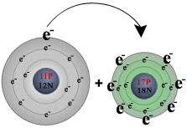
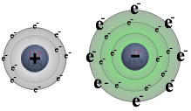
Example of ionic bonding when Na and Cl combine
sodium (on the left) loses its one valence electron to chlorine (on the right),resulting in a positively charged sodium ion (left) and a negatively charged chlorine ion (right).

