Slide 1
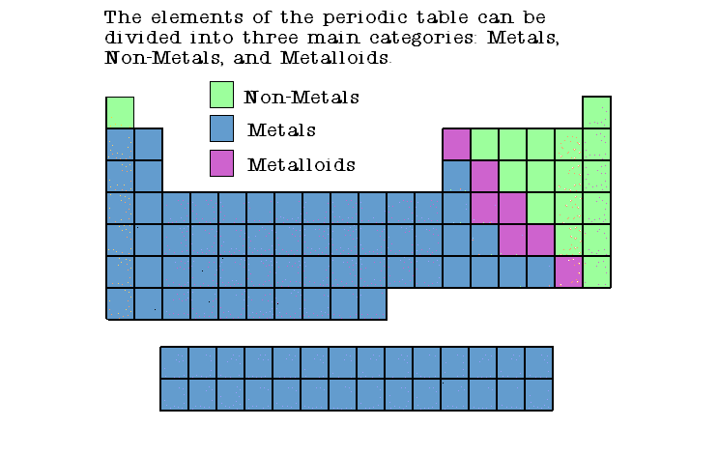
Notes 5/1: Metals, non-metals, metalloids and noble gasses
Metals – found on left side of periodic chart (blue in my example → )
good conductors of heat and electricity
shiny
ductile (can be stretched into thin wires).
malleable (can be pounded into thin sheets).
A chemical property of metal is its reaction with water which results in corrosion.
Non-metals – Found on right side of periodic chart (green in my example → )
poor conductors of heat and electricity – so they are good insulators.
dull
Non-metals are not ductile or malleable.
Solid non-metals are brittle and break easily.
Many are gases.
Metalloids - (metal-like) have properties of both metals and non-metals. (purple in example →)
They are solids that can be shiny or dull.
They conduct heat and electricity better than non-metals but not as well as metals.
They are ductile and malleable.
* Electron shells are also called energy levels.

